Slide 1
Real-Time stock market data web application
- Milind Rathore
From :- Web Developer Group

Slide 2
Index
Introduction
Task Instructions
Key Features – GANTT CHART
Create Project Timeline
Documentation
Gantt Chart
Challenges
Conclusion

Slide 3
Real-Time stock market data web application
Project Description:
Allows users (means investors) to track real-time stock market data in a comprehensible format.
It provides up-to-date information on stock prices, volume, market trends.
Prioritizes user security and privacy, incorporating features like user authentication and robust security measures to safeguard sensitive information

Slide 4
project Timeline
Description:
Chronological Order of Tasks.
Teams understand the project’s schedule and dependencies.
Track progress and identify critical stages.
It promotes efficient resource management.

Slide 5
Task instructions
Key Features – GANTT CHART:
Representation of Gantt Chart
Identifying Dependencies
Monitoring of Milestones
Highlight Critical Path

Slide 6
Why do we need Project Timeline ?
Comprehensive Visual Representation
Overall Manager for project

Slide 7
Let’s create a project timeline
Define the project scope
Break down the project into tasks
Determine task durations
Establish task dependencies
Sequence the tasks
Assign resources
Create the Gantt chart
Adjust and optimize the timeline
Set milestones
Communicate the timeline

Slide 8

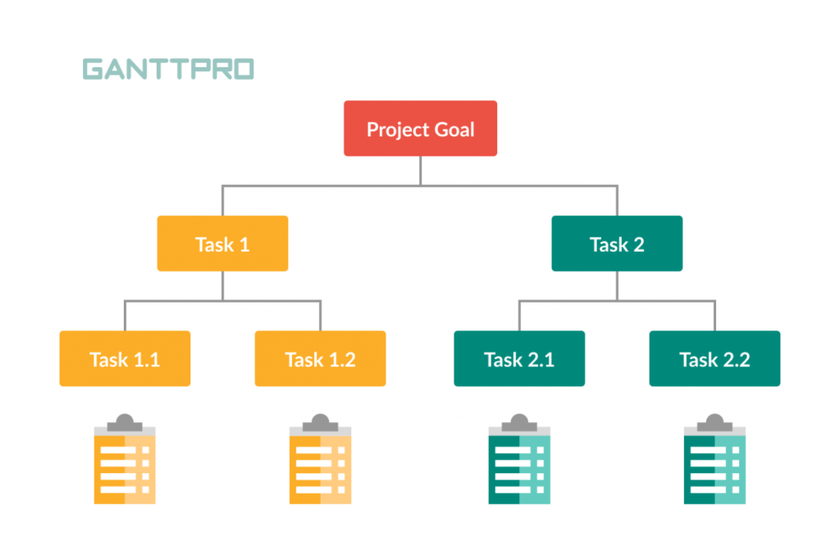
Let’s create a project timeline
I
II
Define a Project Scope
Breakdown the project into tasks

Slide 9

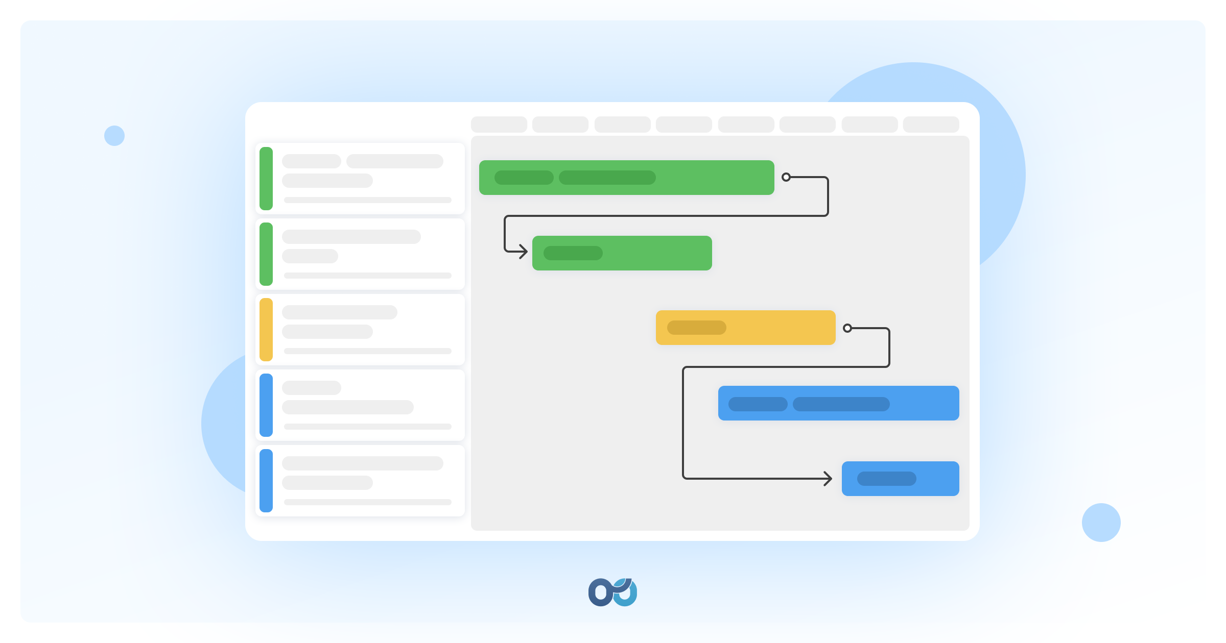
Let’s create a project timeline
III
IV
Determine Task Duration
Establish task dependencies

Slide 10


Let’s create a project timeline
V
VI
Sequence the Task
Assign Resources

Slide 11
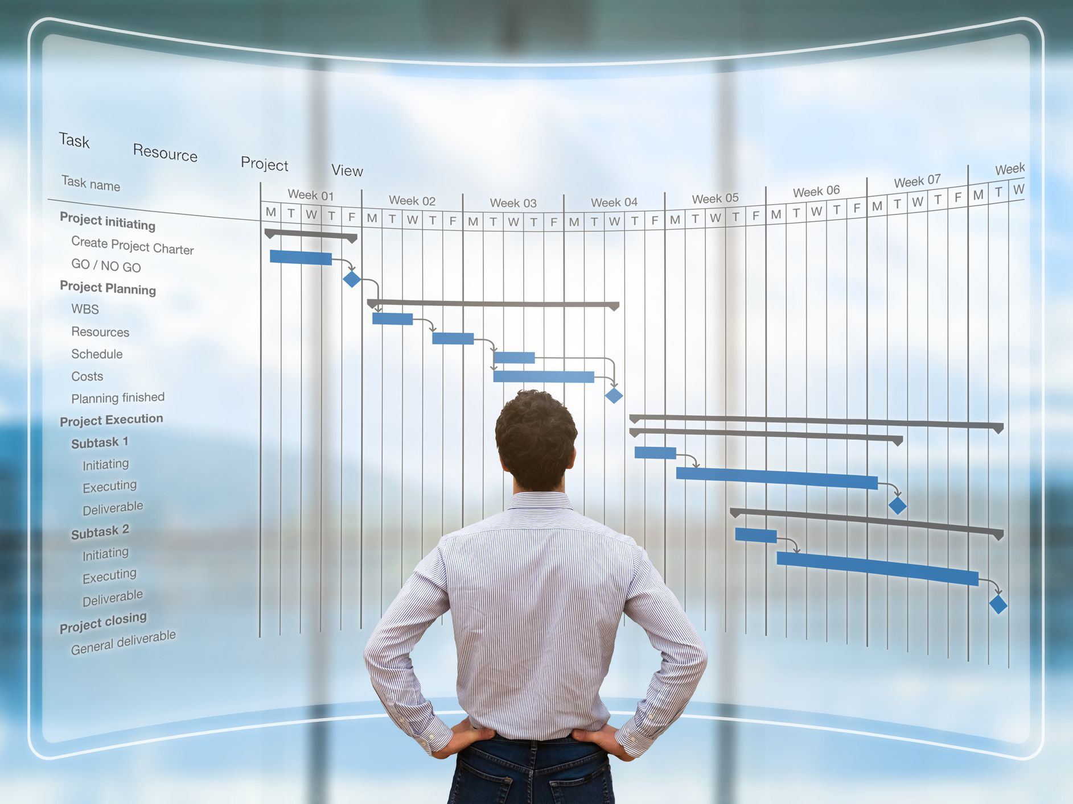

Let’s create a project timeline
VII
VIII
Create a Gantt Chart
Adjust and Optimize the Timeline

Slide 12
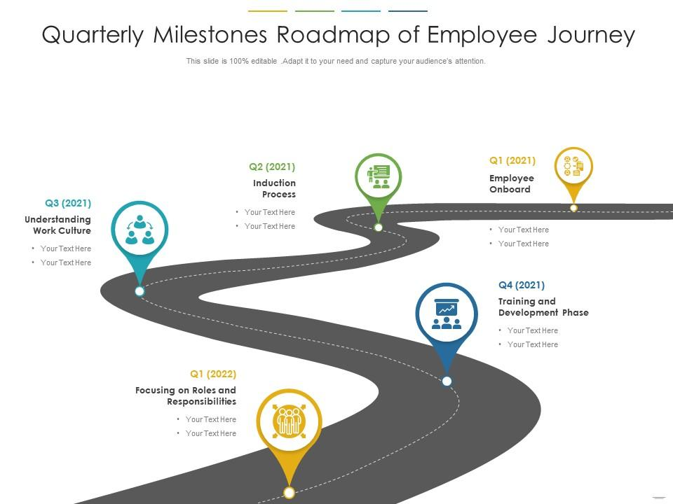
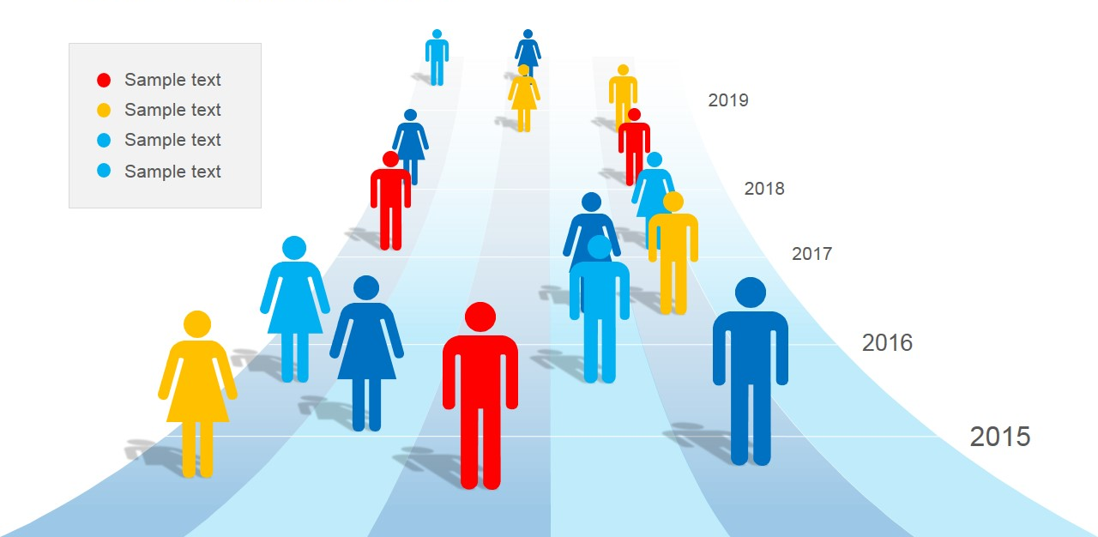
Let’s create a project timeline
IX
X
Set Milestone
Communicate the Timeline

Slide 13
Documentation

Slide 14


TASKS | MONTH-1 |  |  |  | MONTH-2
 | Week-1 | Week-2 | Week-3 | Week-4 | Week-1 | Week-2 | Week-3 | Week-4
Introduction to React.js
Setting up the development environment
Styling the application
Implementing user authentication
Pulling data from APIs
Displaying data on the frontend
Adding search functionality
Testing and debugging
Implementing data visualization
Handling errors and edge cases
Building the backend
Creating APIs
Integrating News API
Implementing real-time updates
Optimizing performance
Deploying the application

Slide 15
Challenges
The main challenge of this project will be:-
Task Estimation
Task Dependencies
Project Complexity
Project Constraints

Slide 16
conclusions
To sum up, utilizing a Gantt chart to create a project timeline is an invaluable asset for project managers. It provides a clear visualization of the project's schedule, task dependencies, and critical path. Nevertheless, challenges like precise task estimation, dependency management, resource allocation, and adapting to changes may arise.
Overcoming these obstacles requires effective communication, collaboration, and adaptability. By addressing these aspects, project timelines developed with Gantt charts establish a strong basis for planning, tracking, and successfully completing projects.

Slide 17
references
1.
2.
3.
https://youtu.be/wp0vr6OkW8Y
https://www.atlassian.com/agile/project-management/gantt-chart#:~:text=What%20is%20a%20Gantt%20chart,schedule%20bars%20that%20visualize%20work
https://analysistabs.com/gantt-chart/advantages-disadvantages/

Slide 18
THANK YOU
Milind Rathore
2020mcb1241@iitrpr.ac.in

